Slide 1
The Medicine Wheel

Slide 2
Medicine Wheel
The reason this object is called a “Medicine Wheel” is due to the strong spiritual healing present when all of the representative symbols are in balance and are united.
Medicine Wheels consist of many different aspects which connect humans and all living things to the Earth.
The medicine wheel is a meaningful reminder of the need to strive for balance, wholeness, and harmony in all things.

Slide 3
The Medicine Wheel serves to remind us of our place in this world, how we each have an impact through our actions and how we are connected in many ways to our natural world.
Negative impacts would result should we change the balance of things, which eventually will be felt by all.
If humans care for the earth and cherish all within it, we can create a healthy world-wide ecosystem where all can benefit.
Notes:
Sometimes the Medicine Wheel tells how things are in the world (Seasons, parts of the Day, etc.), sometimes it shows how a balance must be maintained (Wellbeing), sometimes it shows a balance between the realms (Summer/Afternoon/Water, Winter/Night, etc.)

Slide 4
Assignment
Draw a circle with an X in it, like the ones on the following slides.
Label the four directions of your Medicine Wheel on the outside of the circle.
Label each of the quadrants of the Medicine Wheel with the Seasons, Parts of the Day, Stages of Life, Elements, Wellbeing, Medicines, and Spirit Helpers within the appropriate quadrant.
Write the quotes from the last two slides on your paper as well.
Colour your Medicine Wheel.

Slide 5
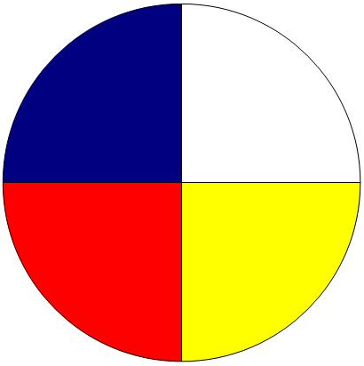
North
Directions
The Four
West
East
South
Notes:
Notice the colours used in this Medicine Wheel. It may not be the colours you have commonly seen. The Cree Medicine Wheel has a blue quadrant, rather than black of the Sioux or Anishinaabe Medicine Wheels. The Cree regard black as a negative colour and therefore do not use black in their Medicine Wheel.
The Medicine Wheel is a circle. A circle does not have a beginning and does not have an end.
I always start in the east and move in a clock-wise direction. You will see why in later slides.

Slide 6
Europeans
Human Races
The Four
Africans
Asians
First Nations
Notes:
Asians – the Europeans refer to them as the yellow people from the East.
Aboriginal – in the South. Referred to by Europeans as ‘Red Skins’. This term is a result of the Europeans watching the Sioux people on the plains. There were not trees for protection form the sun. The Sioux were in the sun all day and their skin would turn red.
African – in the West. In the Sioux and Anishinaabe Medicine Wheel, this quadrant is black – the colour of Negroes’ skin.
Europeans – in the North with white skin.

Slide 7
Winter
Seasons
The Four
Fall
Spring
Summer
Notes:
Spring – in the East. This is when everything comes alive. The grasses start to grow, the leaves come out on the trees, the geese come back, baby moose are born, birds lay their eggs, and later in spring, they hatch.
Summer – in the South. The hottest time of the year.
Fall – in the west.
Winter – in the North. This is when the Earth rests under a blanket of snow.

Slide 8
Night
of the Day
The Four Parts
Evening
Morning
Afternoon
Notes:
Morning – in the East. The start of the day, where the sun comes up.
Afternoon – in the South. The hottest part of the day.
Evening – in the West.
Night – in the North. When we rest.

Slide 9
Elder
Stages of Life
The Four
Adult
Birth
Youth
Notes:
Birth – in the East. Where life begins.
Youth/Childhood – in the South.
Adult – in the West.
Elder – in the North. What colour is an Elder’s hair?

Slide 10
Wind
Elements
The Four
Earth
Fire
Water
Notes:
The Four Elements are necessary for life on Earth. If one of them is not present, there would not be life on Earth.
Fire – in the East. Where the sun comes up. We need the sun to warm the Earth, to grow the plants. Without plants we would not have medicines and the animals would not have food. Without animals, we have nothing to eat.
Water – in the South. Water in the South balances the hottest part of the day and hottest part of the year. Without water, there would be no life on Earth. Our bodies are 60% water.
Earth – Soil is necessary for plants to grow. Many organisms live in the soil which provide nutrients for plants.
Wind – in the North. In winter, most of our wind/air comes from the North in winter. Wind is responsible for mixing the air. It brings us oxygen from the plants and takes our carbon dioxide to the plants. It is also responsible for brining us warmth and rain.

Slide 11
Mental
The Four
Realms of Wellbeing
Physical
Spiritual
Emotional
Notes:
Spiritual – in the East. This is when we say our morning prayers, thanking the Creator for allowing us to experience another day.
Emotional – in the South. This is connected to childhood. Think of how many emotions you go through in a day – from happy to mad, to sad, to happy again. Children can move from one emotion to another in a short period of time.
Physical – in the West. This is connected to adulthood. It is adults that work to sustain their families.
Mental – in the North. This is connected to elders. Elders have a lifetime of experiences. They use their wisdom to make good decisions.

Slide 12
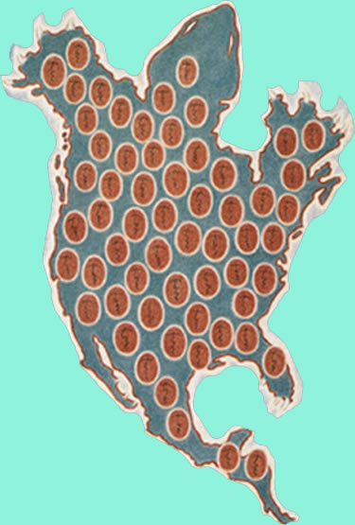
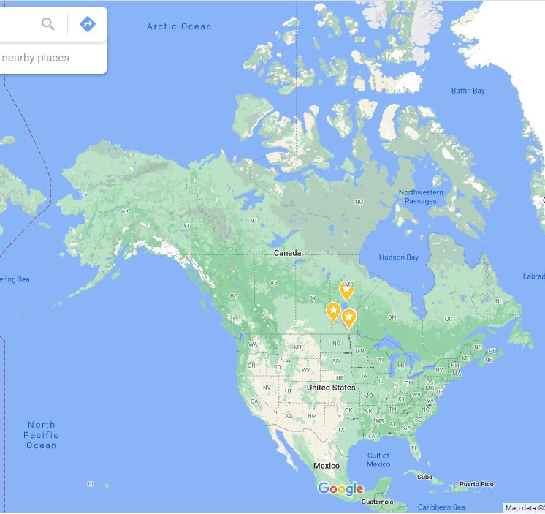
Turtle Island – North America
Notes:
Compare the image of the turtle on the left to the image of North America on the right. This is why First Nations refer to North America as Turtle Island. The Indigenous People knew about Turtle Island thousands of years before there were maps. How did they know the shape of North America? There are Creation Stories that support this belief of the creation of Turtle Island. The Four Sacred Medicines were the first to grow on Turtle Island.

Slide 13
Sweetgrass
The Sacred
Medicines
Sage
Tobacco
Cedar
Notes:
When Turtle Island (North America) was created, the sacred medicines, gifts from the Creator were the first to grow. They grew on all four sides of the burial of Sky Woman’s daughter (the first human to die on Turtle Island).
Tobacco – in the East. This ties to the Spiritual Realm of Wellbeing. It is used in pipe ceremonies or offered to a sacred fire when we pray. The spirit of Tobacco (smoke) carries our prayers and will take our heart, mind (dreams and visions) and intention (commitment) to the Creator in a good way. Tobacco is also offered as a gift to those from whom we need support (Knowledge Keepers, Elders, medicines, animals). When we pass or accept tobacco, it should always be with good intention and humility. When we hold Tobacco, we are holding our relatives, our families, Mother Earth, the water, the animals…all life. Spirits like Tobacco too, and some nations believe it came from Creator’s heart.
Cedar – in the South. Cedar is used to purify the home. It also has many restorative medicinal uses. Cedar baths are healing. When feeling weak and hungry, put Cedar in your mouth to rejuvenate oneself. When Cedar is put in the fire with Tobacco, it crackles. When it does this, it is calling the attention of the spirits to the offering that is being made. Cedar is used in fasting and sweat lodge ceremonies as a form of protection. Cedar branches cover the floor of the sweat lodge and a circle of Cedar surrounds the faster's lodge.
Sage – in the West. The smudge of this medicine is very strong and nurturing like the woman. With the smudge, wash your hair, your mind (to think positively), your eyes (to see positive things), your ears (to hear positive things), mouth (to speak positively) and heart (to make everyone feel welcome). Wash your whole body and ask the spirit of this medicine to take care of you. Sage is used to prepare people for ceremonies and teachings. Because it is more medicinal and stronger than Sweetgrass, it tends to be used more often in ceremonies. Sage is used for releasing what is troubling the mind and for removing negative energy. It is also used for cleansing homes and sacred items. It also has other medicinal uses. There is male Sage and female Sage. The female Sage is used by women.
Sweetgrass – in the North. Sweetgrass (Wihkask) comes from the word Wikaskotihyen which means to walk through the hard times. Therefore, smudging with Sweetgrass will help you be strong when times are tough. Sweetgrass is the sacred hair of Mother Earth. The three braids of the sweetgrass can represent past, present, and future; love, peace and harmony; or mind, body and spirit. Its sweet aroma reminds people of the gentleness, love and kindness she has for the people. When Sweetgrass is used in a healing circle it has a calming effect. Like Sage and Cedar, Sweetgrass is used for smudging and purification. We use Sweetgrass to cleanse negativity from our being and our space.

Slide 14
Buffalo
The Animal
Spirit Helpers
Bear
Eagle
Wolf
Notes:
The Creator came to the animals and told them that he was going to create the most pitiful of his creations – human beings. They would need a lot of help. He told the animals he would need volunteers. Some offered their service to help us. We rely on everything on Earth to survive.
Eagle – in the East. The Eagle is connected to Spirituality. The Eagle’s job is to carry our prayers to the Creator. He is the one that flies so high, he is closest to the Creator; therefore, he is able to deliver our prayers to the Creator.
Wolf – in the South. This is linked to Emotions. When we die, our spirit follows the Muhigan Meskinow (Wolf Trail) back to the Hole in the Sky. At a funeral, you can hear the wolf in the grieving of family members.
Bear – in the West. When humans first came to Earth, Bear, our brother, was the one who taught us many things about living on Mother Earth.
The Creator was looking for one more helper. Moose came forward and offered to help, but the Creator knew that the Moose had a bad temper. He thanked the moose for his offer, but told him he was not the right animal for this work. The moose got angry and charged at the Creator. The Creator put his hands on moose’s antlers and stopped him. To this day you can see the hand prints on the moose’s antlers. The shovels are the palm prints of the Creator. The spikes on the antlers are where the antler came between the Creator’s fingers.
Bison – in the North. When Creator asked for a fourth animal to volunteer to help humans, Bison stepped forward and said he would offer his body to feed the humans.

Slide 15
Everything in life is Sacred.
Everything we do is Spiritual.

Slide 16
Humankind has not
woven the web of life.
We are but one thread within it.
Whatever we do to the web,
we do to ourselves.
All things are bound together.
All things connect.
-Chief Seattle-

