Slide 1
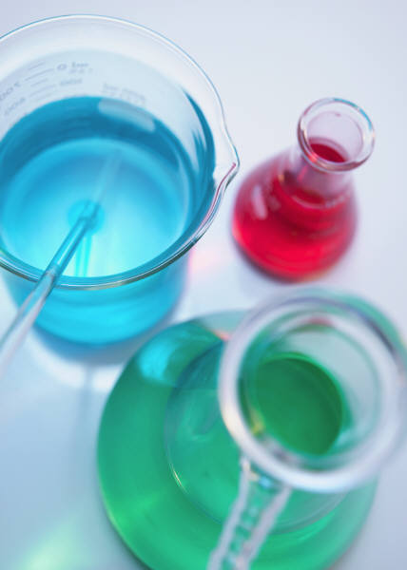
What are they?
Where do we find them?
How do we describe them?
Mixtures and Solutions

Slide 2
Parts of a Solution
Solvent
dissolving medium
(…the dissolver)
Solute
dissolved substance
(the dissolvey)
Solution
The solute and solvent together
Solvents and solutes can be any phase.
Solid, liquid, gas

Slide 3
Electrolytes
Electrolytes
Solutions that conduct electricity.
Ionic solutions are electrolytes.
Covalent solutions are nonelectrolytes.
Is saltwater (NaCl in water) an electrolyte?
Is sugar water (C₆H₁₂O₆ in water) an electrolyte?
Conductivity tester
Can tell us if a solution is an electrolyte, and sometimes, how strong an electrolyte is.

Slide 4
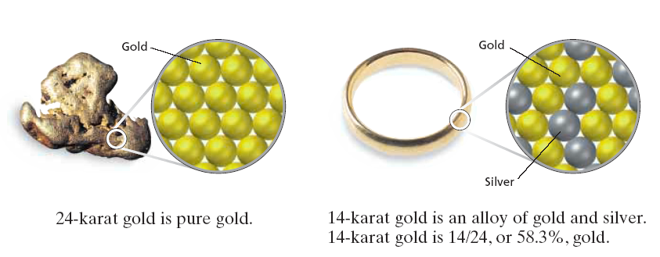
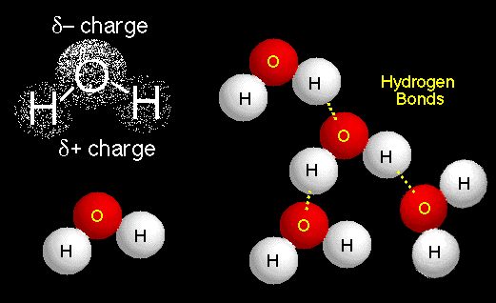
Soluble and Insoluble
Soluble means: able to be dissolved.
Ionic solids (cation and anion) dissociate into their ions in water.
Covalent solids (like sugar) dissolve when they are relatively polar.
The dissolved particles cannot be easily seen or separated from the solution.
“Like dissolves like”
Alloys are solutions of metals!
Solubility depends upon temperature…

Slide 5
Increasing temperature increases the solubility of solids in liquids Increasing temperature decreases the solubility of gases in liquids! …

Slide 6
Gases in Liquids
In addition to cold temperatures, high pressures increase solubility of gasses in liquids.
Henry’s Law:
solubility of a gas in a liquid increases with increasing pressure of that gas above the liquid.

Slide 7
Saturation
Saturated Solution
solution has as much solute as it will allow, adding more solute = just fall through solution.
Unsaturated Solution
more solute can dissolve into solution
Supersaturated Solution
too much solute in solution - some solute will leave the solution
Solvent-Solute Molecule Interactions
As interactions increase, rate of dissolving …?
What actions speed up dissolving?

Slide 8
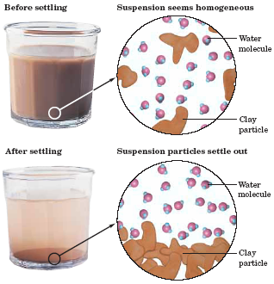
Special Types of Mixtures - Suspensions
Suspensions
solute particles are very large, so they don’t completely dissolve into their solvent.
Solute particles will settle out of the solution if left undisturbed. – this creates two phases.
Muddy water and Italian salad dressing are good examples of suspensions.

Slide 9
Special Types of Mixtures Colloids
Colloids
solute particle is smaller than particles in a suspension, but not small enough to dissolve.
Colloids have two phases:
Dispersed phase – the solute
Dispersing medium – the solvent.
Mayonnaise and hair gel are good examples of colloids.
There are 8 types of colloids, found on your handout

Slide 10
8 Types of Colloids
Colloid Type | Phases | Example
Solid Sol | Coloured gems | aquamarine
Sol | solid in liquid, liquid substance | Paint
Gel | solid in liquid, solid substance | Gelatin
Foam | gas in liquid | Whipped cream
Liquid Emulsion | liquid in liquid | Milk, mayonnaise
Solid Emulsion | liquid in solid | Cheese, butter
Solid Aerosol | solid in gas | Smoke
Liquid Aerosol | liquid in gas | Clouds, fog
Two groups of colloids:
Heterogeneous colloids – two phases are clearly seen
Homogeneous colloids – appears to be one phase

Slide 11
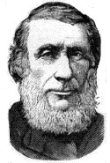
The Tyndall Effect
John Tyndall, British, c1860
The Tyndall effect allows us to distinguish between solutions, colloids, and suspensions.
It works by shining a beam of light into the mixture. If…
Light is blocked at entry into the mixture
the mixture is a suspension.
Light passes through unobstructed
the mixture is a solution.
Light passes, but the beam can be seen in the mixture
the mixture is a colloid.

Slide 12
Dissociation and Ions Present
Dissociation = a salt dissolving into its ions:
How many moles of ions are in a solution of 1 mole of NaCl?
How many moles of ions are in solutions of 1 mole of each of the following?:

